Slide 1
IFA 2013
Event Analysis
01 Aug 2013 – 11 Sept 2013

Slide 2
Introduction
With IFA 2013 having wrapped up, we conducted some event analysis to see which brands had the greatest impact during the event and its lead-up, and which products drove the most debate.
This report looks at brand Share of Voice, top products by category (Smartphones, Tablets and Laptop-Tablet Hybrids), and brand sentiment. We have also identified the most influential IFA 2013 stakeholders both on Twitter and within the wider online debate.
IFA 2013 > Introduction

Slide 3
01
Brand Attention
Which brands had the greatest Share of Voice at IFA 2013?

Slide 4
Samsung and Sony saw overall highest Share of Voice, although other brands caught up during event
Samsung and Sony led brand discussions around IFA 2013, between them accounting for 53% of all brand attention at the event, and around 68% of pre-event attention. However, players such as Acer and Lenovo also made a splash, with products like the Acer Liquid S2 and Lenovo Vibe X driving mentions for the brands.
Product launches helped ASUS, Alcatel, LG and Toshiba increase their Share of Voice at the event, eating into Samsung and Sony’s dominance.
On the other hand, HTC, HP and Nokia (who were not present at IFA 2013) were less successful in driving conversations around their product launches, seeing little cut-through.
IFA 2013 > Brand Share of Voice

Slide 5
02
Event Timeline
Key events at IFA 2013

Slide 6
Event Timeline: Product discussions, brand presentations and event wrap-ups drove attention in Samsung’s favour
LG generated buzz with pre-IFA G Pad 8.3 announcement
Samsung and Sony presentations spark spike in debate
ASUS peak driven by Fonepad previews
Acer’s Liquid S2 praised for its “compelling” 4K camera
Lenovo grabbed headlines with Vibe X and S5000 unveilings
Samsung attention sustained through product discussions, podcasts and event wrap-ups
IFA 2013 > Event Timeline

Slide 7
03
Top Products
Which products seized the day to grab the most attention?

Slide 8
Top Products: Smartphones and Smartwatches key conversation drivers, with Galaxy Note III stealing show
Rank | Brand | Product | Category
1 | Samsung | Galaxy Note III | Smartphone
2 | Samsung | Galaxy Gear | Smartwatch
3 | Sony | Xperia Z1 | Smartphone
4 | LG | G Pad 8.3 | Tablet
5 | HTC | One Max | Smartphone
6 | Lenovo | Vibe X | Smartphone
7 | Samsung | Note 10.1 2014 | Tablet
8 | Acer | Liquid S2 | Smartphone
9 | LG | G2 | Smartphone
10 | Sony | SmartWatch 2 | Smartwatch
11 | ASUS | Fonepad 7 | Tablet
12 | Acer | Iconia A3 | Tablet
IFA 2013 > Top Products

Slide 9
Smartphones: Samsung and Sony saw highest Share of Voice, with Galaxy Note III dominating discussion
Rank | Smartphone
1 | Samsung Galaxy Note III
2 | Sony Xperia Z1
3 | LG G2
4 | Lenovo Vibe X
5 | HTC One Max
6 | Acer Liquid S2
7 | iPhone 5S
8 | HTC One mini
9 | Nokia Lumia 1020
10 | Alcatel One Touch Idol Alpha
11 | iPhone 5c
12 | HTC One Blue/Red
13 | Archos Platinum Range
14 | Alcatel One Touch Hero
15 | HTC Desire 601
Samsung’s Galaxy Note III and Sony’s Xperia Z1 were the smartphones driving the most attention during IFA 2013, with the Galaxy Note III lauded for its premium feel, slick performance and S Pen functions.
HTC devices such as the One Max saw strong coverage during the pre-IFA build-up, but lost momentum during the event.
The Acer Liquid S2 and Lenovo Vibe X performed strongly following their unveilings. GSMArena pegged the Liquid S2 as a serious contender within the high-end smartphone market, due to its “impressive” specifications, build quality, and 4K camera.
IFA 2013 > Top 15 Smartphones

Slide 10
Tablets: LG’s G Pad made a big splash, while Samsung claimed top spot with the launch of the Note 10.1 2014
Rank | Tablet
1 | Samsung Note 10.1 2014
2 | LG G Pad 8.3
3 | Acer Iconia A3
4 | Lenovo IdeaTab S5000
5 | ASUS Fonepad 7
6 | ASUS MeMo Pad 8
7 | ASUS Fonepad Note 6
8 | Panasonic Toughpad 4K
9 | Toshiba Encore
10 | ASUS MeMo Pad 10
Samsung Note 10.1 (2014) seen as a “compelling” product, although there was some negative sentiment regarding its “plasticky” features and aesthetic. Positive sentiment came from the product’s S Pen and multitasking features.
The LG G Pad 8.3 came a close second in terms of attention, with its design, specifications and weight all seen as positive features. However, The Verge regarded the product as “a not yet compelling purchase”, due primarily to its app ecosystem.
IFA 2013 > Top 10 Tablets

Slide 11
Laptop-Tablet Hybrids: Several brands vying for attention, with no clear category owner
Rank | Hybrid
1 | Sony Vaio Tap 11
2 | Lenovo Yoga 2 Pro
3 | Toshiba Satellite Click
4 | ASUS Transformer Pad TF701T
5 | ASUS Transformer Book Trio
6 | ASUS Transformer Book T300
7 | Lenovo ThinkPad Yoga
8 | Sony Vaio Fit Multi-Flip
9 | Lenovo IdeaPad Flex 14
10 | Lenovo IdeaPad Flex 15
11 | HP Split X2
12 | HP Slatebook X2
The Sony Vaio Tap 11 and Lenovo Yoga 2 Pro led the Hybrids category, with the Yoga 2 described by Slash Gear as a “solid refinement” over the original, and the Tap 11 receiving plaudits for its overall design and display.
Though the Toshiba Satellite Click received strong attention, coverage was largely neutral, with Windows Phone Central concluding: “working on a tablet all day means we would usually want a much higher res unit, but for the price – it isn’t bad.”
IFA 2013 > Top 12 Laptop-Tablet Hybrids

Slide 12
04
Sentiment
How were the brands and products perceived at IFA 2013?

Slide 13
Brand Sentiment
Acer saw high levels of Positive and Very Positive Sentiment, driven by launch of “ambitious” Liquid S2 smartphone and “budget” Iconia A3, which was applauded for its affordability.
ASUS saw some Negative Sentiment amongst Tech Media sources, after the firm’s tablet line-up was leaked ahead of IFA.
Samsung saw Mixed Sentiment for its Galaxy Gear device, described by The Verge as “a smartwatch like no other.” CNET points out its “limited scope” but concedes the smartwatch has “set a new bar to meet in wearables.”
Sony’s Xperia Z1 drove Positive Sentiment for the brand, led by features such as its waterproof casing, 20.7MP camera and “handsome” design.
IFA 2013 > Brand Sentiment

Slide 14
05
Top Influencers
Who are the most influential IFA 2013 stakeholders?

Slide 15
Top Influencers
Rank | Stakeholder | Influence Score | Category
1 | Engadget | 67.4 | Vertical Media
2 | The Verge | 57.9 | Vertical Media
3 | SamMobile | 54.6 | Vertical Media
4 | Samsung.com | 32.7 | Business
5 | CNET | 28.6 | Vertical Media
6 | PhoneArena | 28.2 | Vertical Media
7 | Bloomberg | 23.7 | News Media
8 | Sonymobile.com | 21.8 | Business
9 | Reuters | 21.8 | News Media
10 | GSMArena | 18.8 | Vertical Media
11 | VentureBeat | 17.0 | Vertical Media
12 | Phandroid | 16.4 | Vertical Media
13 | ZDNet | 15.9 | Vertical Media
14 | Slash Gear | 15.4 | Vertical Media
15 | The Next Web | 15.2 | Vertical Media
IFA 2013 > Top Influencers

Slide 16
Top Twitter Influencers around #IFA2013:
Rank | Name | Twitter Handle | Influence Score
1 | Lenovo | lenovo | 28842
2 | Andreas Gotthelf | Agotthelf | 23942
3 | Lenovo Deutschland | lenovode | 23204
4 | Panasonic | panasonic | 19137
5 | Martin Schumacher | keineantwort | 18146
6 | Microsoft | Microsoft | 17493
7 | GIGA Android - DE | GIGAandroid | 16322
8 | Microsoft Windows | Windows | 15278
9 | VitaDock | VitaDock | 10128
10 | Francisco De Jesús | worldwidegadget | 8683
11 | Evi Maquoi | EviMaquoi | 8181
12 | gadgetmaniaes | gadgetmaniaes | 5818
13 | Paréntesis.com | parentesiscom | 5298
14 | Microsoft | MicrosoftOEM | 5003
15 | Philips at IFA | Philips_IFA | 4913
16 | What HiFi? | whathifi | 4755
17 | Panasonic España | panasonicESP | 4401
18 | Xataka | Xataka | 4390
19 | Antonio Da Silva Cam | Expectativa67 | 4295
20 | Sony América Latina | SonyLatin | 4171
21 | Froilan Fernandez | Froilan | 3932
22 | ASUS Ibérica | ASUS_ib | 3878
23 | Philips Netherlands | PhilipsNL | 3587
24 | Sony Xperia Colombia | Sonyxperiaco | 3408
25 | Monster | MonsterProducts | 3305
26 | Hiddekel Morrison | IngMorrison | 3304
27 | bnetTV | bnetTV | 2992
28 | Trusted Reviews | Trustedreviews | 2672
29 | IFA 2013 | IFA2013 | 2269
30 | Camilo Uribe | MetCastle | 2265
IFA 2013 > Top Twitter Influencers

Slide 17
Appendix
Our Influence Methodology

Slide 18
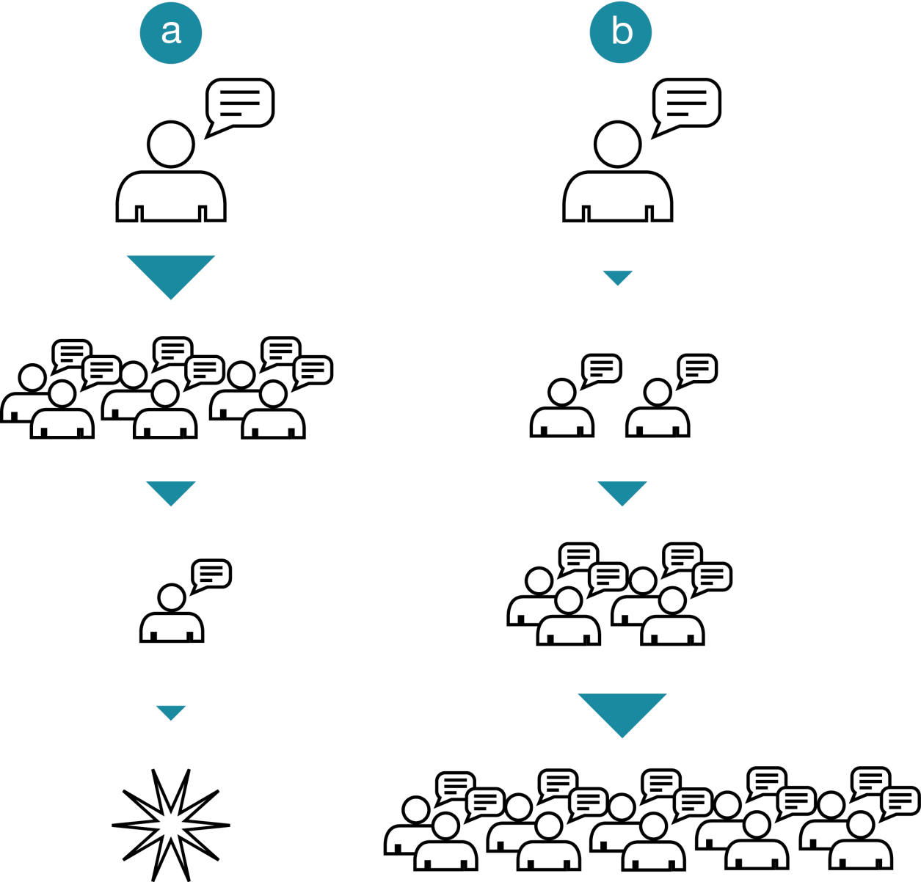
How is influence calculated?
Influence is the capacity of a publication, organisation or individual to impact the actions or opinions of others over whom they do not hold power.
Influence is topical and relative - a Stakeholder with an influence score of 10 has twice the influence of a Stakeholder with an influence score of 5 and so forth.
Influence is calculated by transferring the established citation methodology used in the academic world into online sources. The more a source is linked to, the more influential it becomes. Therefore, a site which is only referenced by other sites a few times will have much less influence than a site whose links spread out far and wide across the internet. In this way, links act as a digital proxy for academic references and the real world.
18
IFA 2013 > Our Methodology

Slide 19
Any Questions?
Please direct any feedback or enquiries towards Tim Williams:
tim.williams@onalytica.com
+44 (0) 203 130 1927

